Slide 1
Explainable AI For Source Code Applications
SDMAY25-30
Manjul Balayar, Sam Frost, Akhilesh Nevatia, Ethan Rogers, Rayne Wilde
Client: Dr. Ali Jannesari
Advisor: Arushi Sharma

Slide 2
Briefly, Our Goal
Peer into the internals of Large Language Models (LLMs) when they are given code inputs
Look at the activations passed through the model
Extract Activations
Cluster Activations
Analyze Activations
Visualize Activations
What can this tell us?

Slide 3
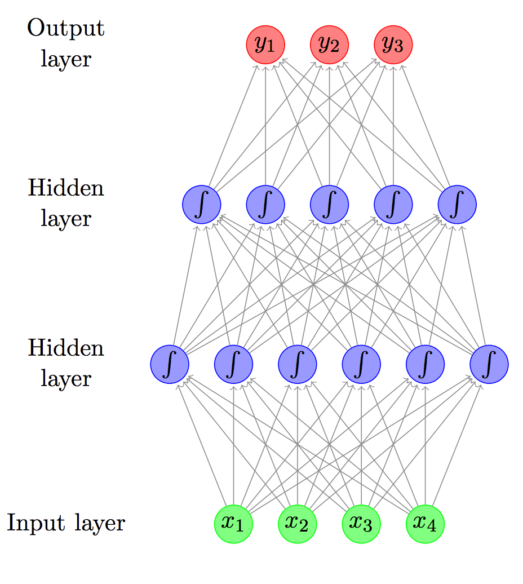
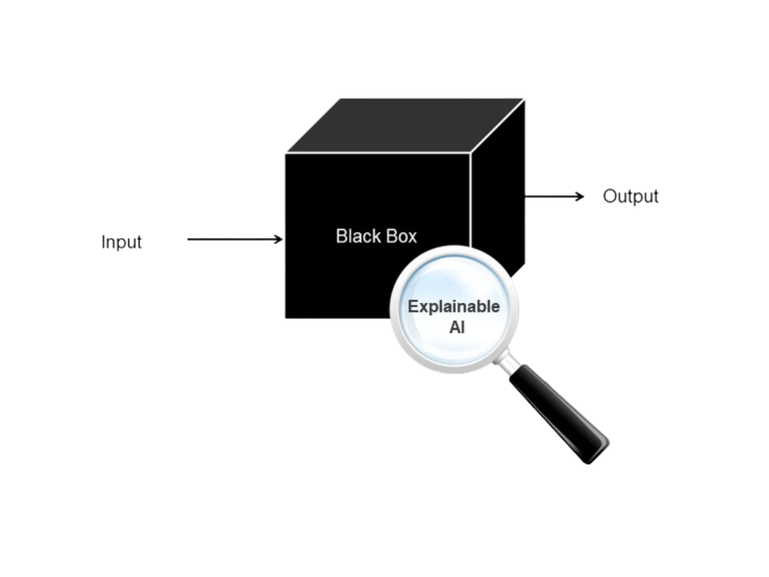
Introduction/Background
The current state of AI is data-driven statistical learning to minimize error
Define a model, provide relevant data, let it learn
Minimal knowledge on learning intricacies
Deep learning = Many layers to abstract data for complex tasks
Neuron

Slide 4
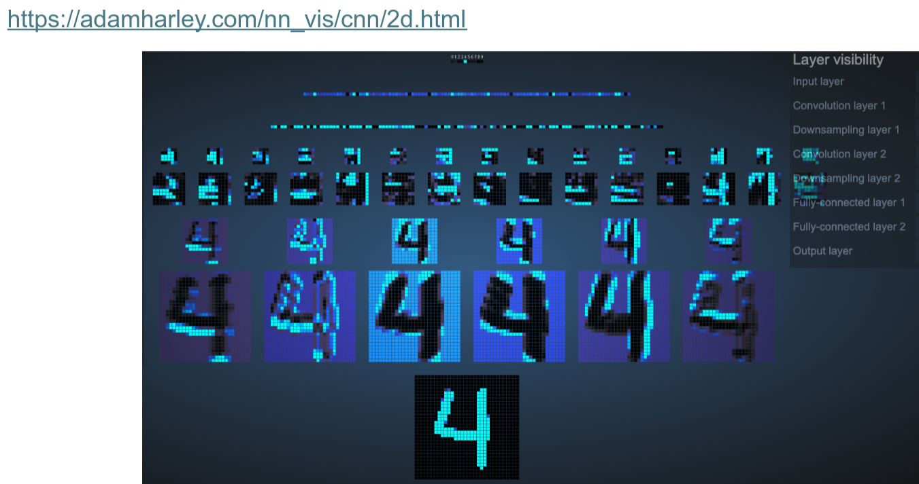
Example of AI’s explainability using a CNN for MNIST’s handwritten digits classification

Slide 5
Project Overview
Abstract
“This project focuses on auto-labeling code datasets to capture different code properties.”
Goal
Improve our ability to understand LLMs by:
Creating a modular workflow enabling extraction, clustering, and evaluation of model activations.
Building a scalable framework that can be deployed across:
Local Environments
Google Colab (Cloud)
High Performance Computing (HPC) Clusters
Visualizing clustered model activations.

Slide 6
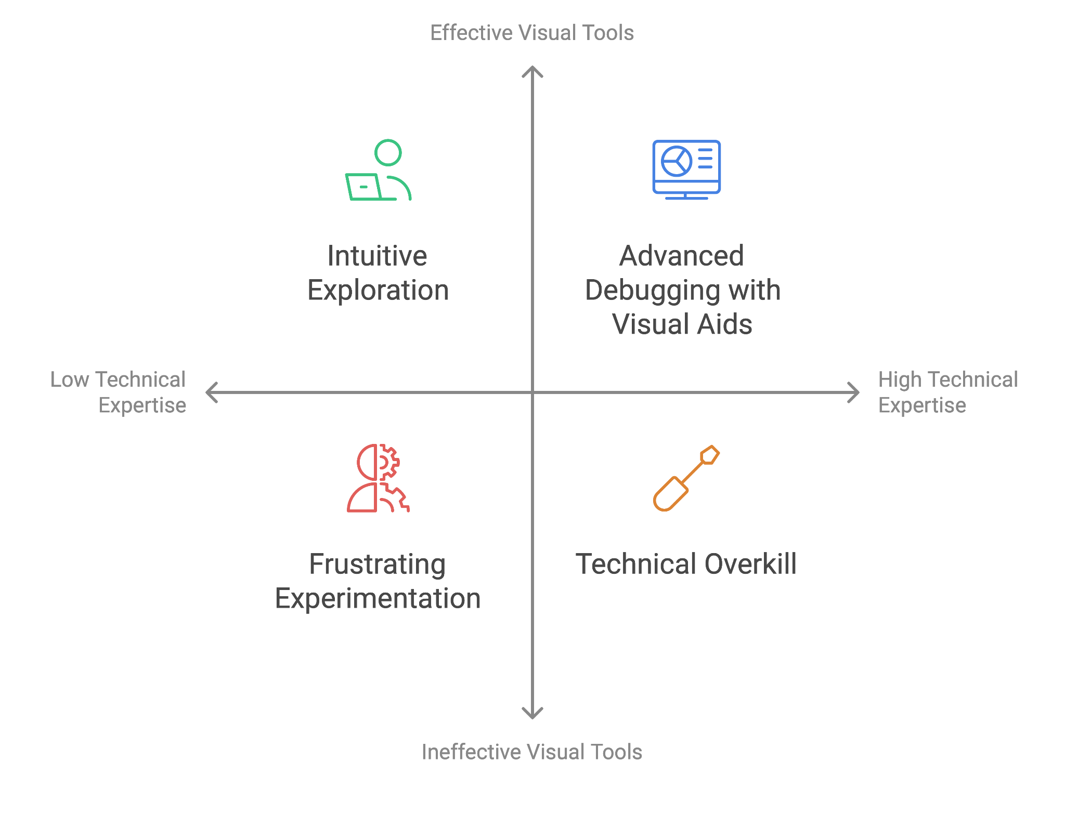
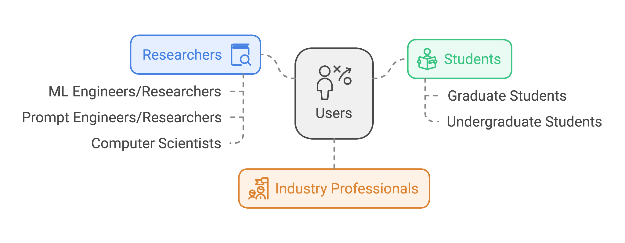
Why This Problem: Primary Users and Needs
“Many of the risks and worries associated with generative AI are ultimately consequences of this opacity, and would be much easier to address if the models were interpretable” - Dario Amodei (CEO of Anthropic)
1. Machine Learning Researchers and Engineers
Researchers need a tool to analyze latent concepts and neuron behaviors in ML models for better interpretability and performance optimization.
2. People Experimenting with ML Models
Seek intuitive methods to explore model behaviors and emergent patterns without needing extensive technical expertise.

Slide 7
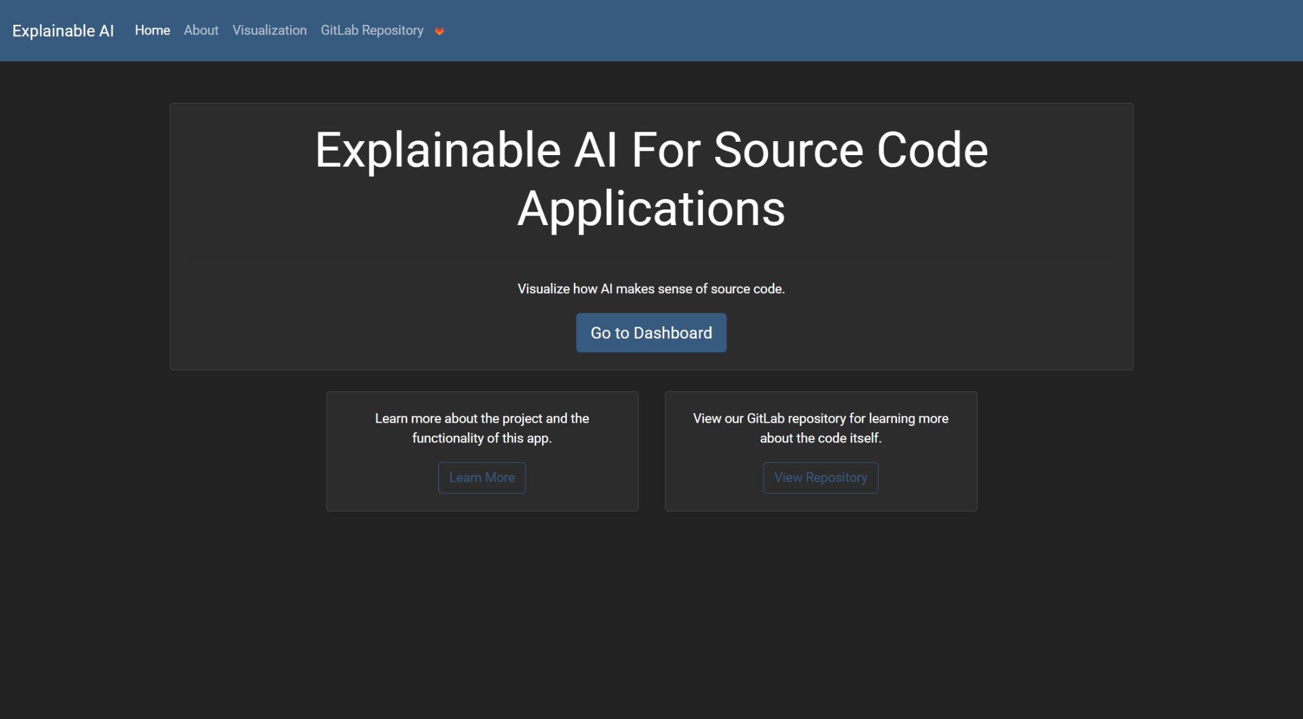
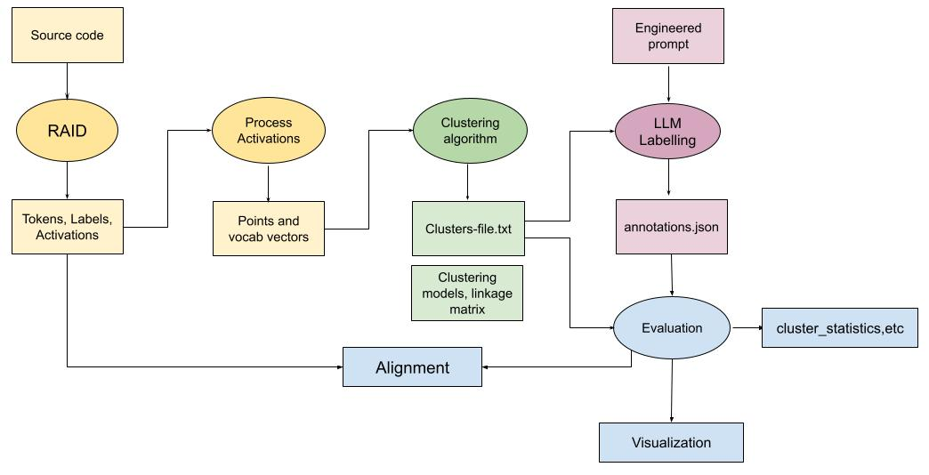
How We Solved the Problem: Sub Problems

Slide 8
Beginning With: Activation Extraction
Notes:
Moving on to our product's design, we first process our source code through our RAID tool to parse code and generate tokens and activations which are then transformed into points and vocabulary vectors, which serve as input for our clustering algorithms.
We also use engineered prompts with Large Language Models to generate semantic labels for our clusters. Finally, we analyze the clustering results through different evaluation methods and visualizations.

Slide 9
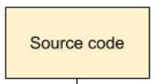
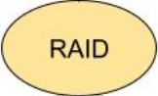
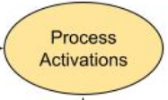
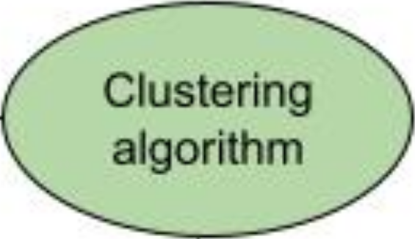
Activation Extraction: Recording the LLMs internals
Have some code that you want to process
Run that code through your target model (e.g. CodeBERT)
Organize relevant data for the target code
Tokens: Tokenize the code as the LLM would see it
Labels: Each keyword of code can be given a unique identifier
Activations: The interlayer values from the LLM for processing
Points & Vocab from Extracted Activations
Vocab: All token given to the model
Points: The activation associated with each token (unique for each layer)
To be used by other parts of the pipeline!
Notes:
Next we have our key functionalities of our system. For data input, users can load different types of source code files like in a CSV or JSON formats.
For model selection, user can either utilize a pre-trained model from Hugging Face or import custom models. They can then specify which layers to extract from and then prepare the data for our clustering phase which offers multiple clustering algorithms.
For evaluation, users can define specific alignment metrics using lexical or contextual criteria. The system then assesses how well do these clusters align with known concepts.
And then finally users can then visualize cluster relationships through our interactive visualization tool.
**For labeling, we plan to implement DSPY2 supported by a user interface.
**Additionally, users can perform probing and reverse feature engineering to extract any meaningful features from latent representations, to help them understand how the model interprets different code patterns.

Slide 10
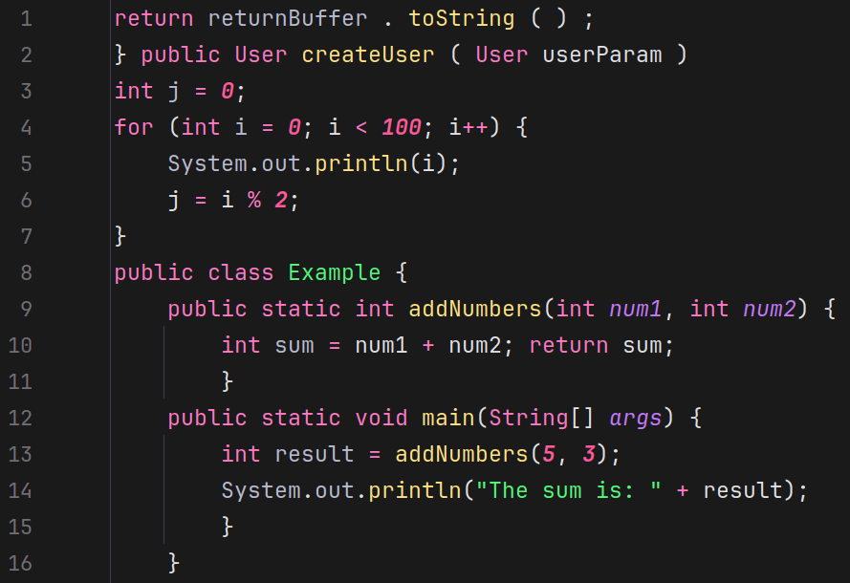
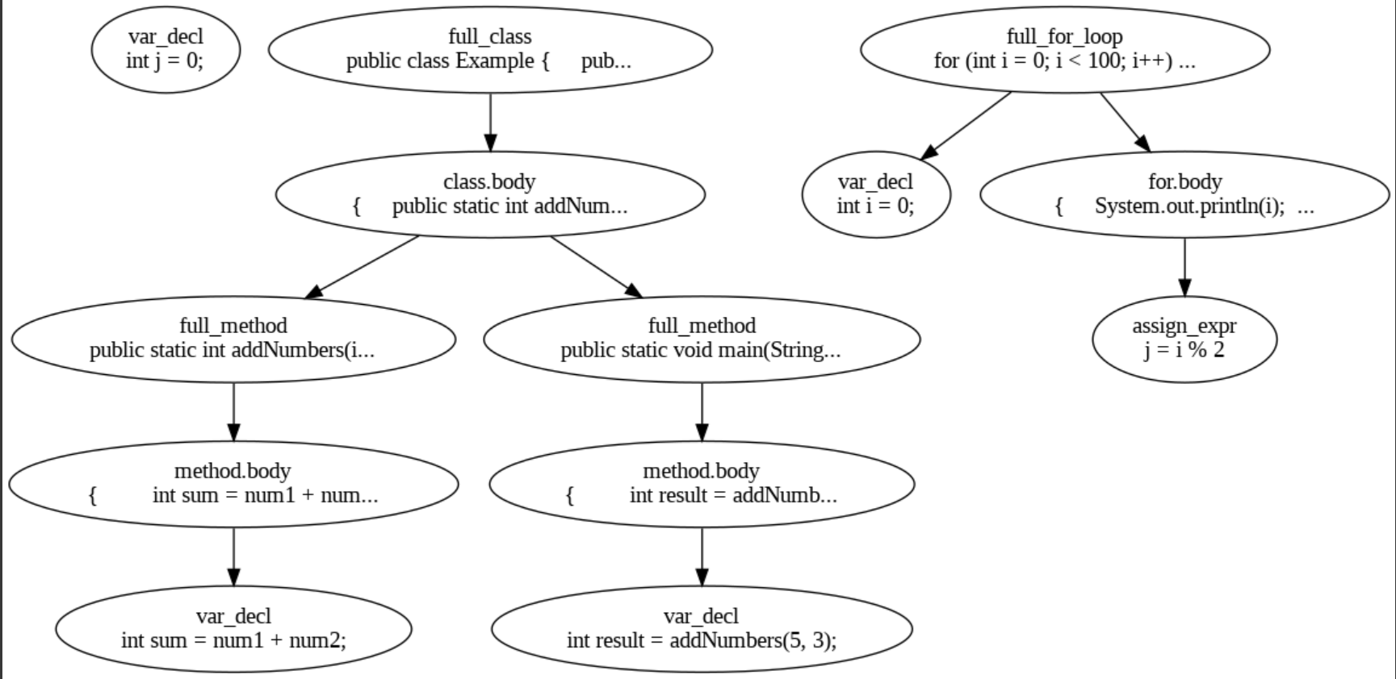
Activation Extraction: Hierarchical Extraction
Alternatively, you can extract the activations for a code hierarchy!
How does the LLM view specific
structures or concepts?
Some sample java code
All members’
activations
Extracted code nodes with parent/child relations
Notes:
Next we have our key functionalities of our system. For data input, users can load different types of source code files like in a CSV or JSON formats.
For model selection, user can either utilize a pre-trained model from Hugging Face or import custom models. They can then specify which layers to extract from and then prepare the data for our clustering phase which offers multiple clustering algorithms.
For evaluation, users can define specific alignment metrics using lexical or contextual criteria. The system then assesses how well do these clusters align with known concepts.
And then finally users can then visualize cluster relationships through our interactive visualization tool.
**For labeling, we plan to implement DSPY2 supported by a user interface.
**Additionally, users can perform probing and reverse feature engineering to extract any meaningful features from latent representations, to help them understand how the model interprets different code patterns.

Slide 11
Next up: Clustering Workflow
Notes:
Moving on to our product's design, we first process our source code through our RAID tool to parse code and generate tokens and activations which are then transformed into points and vocabulary vectors, which serve as input for our clustering algorithms.
We also use engineered prompts with Large Language Models to generate semantic labels for our clusters. Finally, we analyze the clustering results through different evaluation methods and visualizations.

Slide 12
Clustering: Making sense of what your LLM thinks
Imagine a massive library where books (code tokens) have been arranged by an expert librarian who never explained their system. Our clustering is like discovering the hidden organization principles - finding which books the librarian considers similar enough to place on the same shelf.
Librarian -> Model
Organization Principles -> How the model learns
What Clustering Does?
Input: Processed Neural Activations (how AI model represents each code token internally)
Process: Group similar activation patterns together to find relationships
Output: Groups of tokens model perceives to be similar

Slide 13
Clustering Approaches: Right tool for the Right insight
Different clustering methods reveal different aspects of how the model perceives code, giving us a multifaceted view of its 'understanding'
Our Arsenal includes:
K-Means: The "quick sorter" - groups similar code elements into clear, distinct buckets
Agglomerative: The "relationship builder" - shows how code concepts gradually connect into a hierarchy
Leaders: The "flexible organizer" - adapts to find both tight-knit groups and looser associations
BIRCH: The "big data handler" - efficiently processes huge amounts of code without slowing down
Hyperbolic (hyPHC): The "tree mapper" - Maps code concepts into a non-euclidian space to better preserve hierarchical relationships

Slide 14
Lastly: Alignment and Evaluation
Notes:
Moving on to our product's design, we first process our source code through our RAID tool to parse code and generate tokens and activations which are then transformed into points and vocabulary vectors, which serve as input for our clustering algorithms.
We also use engineered prompts with Large Language Models to generate semantic labels for our clusters. Finally, we analyze the clustering results through different evaluation methods and visualizations.

Slide 15
Alignment: Connecting Clusters to Meaning
What is Alignment?
The process of mapping abstract clusters back to human-understandable concepts
Like translating the librarian’s secret organizational system back to human language
The Challenge
Clusters are mathematical groupings with no inherent meaning
How do we interpret what each cluster represents in terms of code concept?
Our Approach:
Method M1: Direct frequency-based matching of words to labels
Method M2: Enhances M1 by calculating the proportion of words in a cluster that match a specific label
Both compare code tokens in clusters against know labeled examples
Input: Clusters from previous state + Labeled ground truth data
Output: Meaningful labels for clusters (e.g., ‘function_call’, ‘loop_condition’, ‘variable_declaration’)

Slide 16
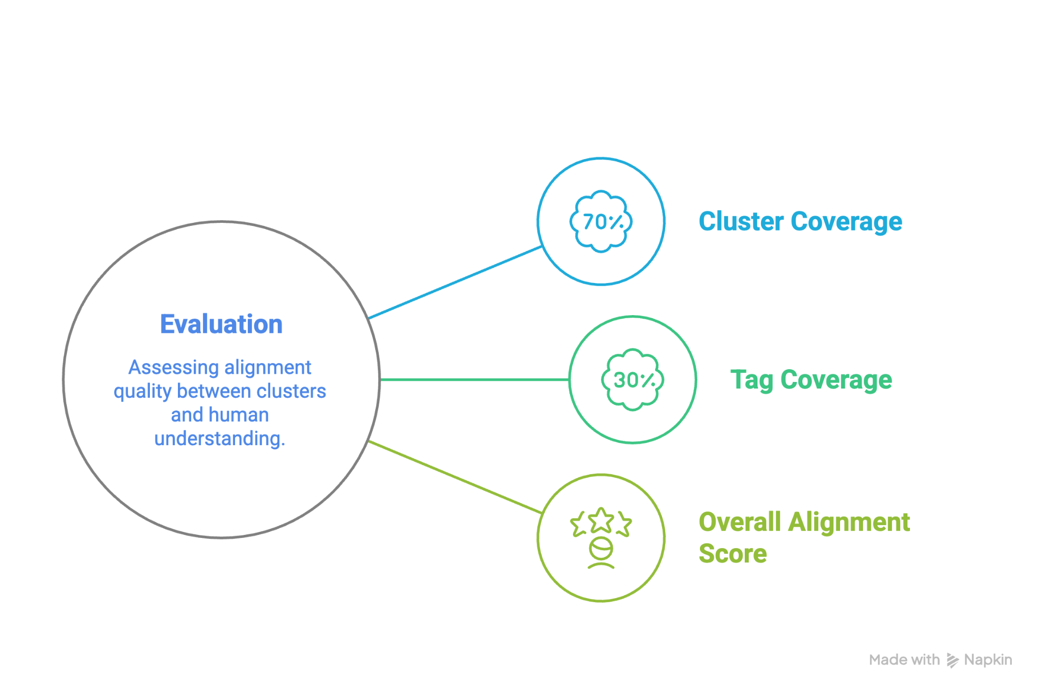
Evaluation: Measuring Alignment Quality

Slide 17
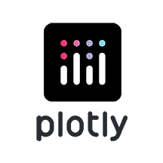
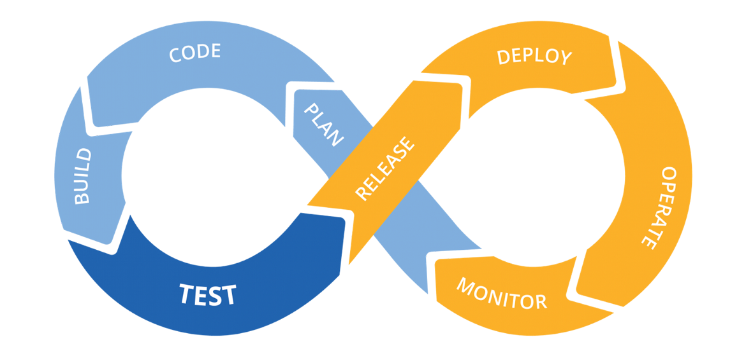
Library & Deployment
📦 Library Packaging | ⚙️ CI & Containerization | 🚀 Production Deployment
Version bump in setup.py (e.g. 0.2.3 → 0.2.4) | Automated build via GitLab CI | SSH into server, e.g. pyrite.cs.iastate.edu
Create package (wheel + source distribution) | Containerize using Kaniko (secure, rootless build) | Pull image (tagged by commit & “latest”)
Publish to internal PyPI registry | Tag images with both commit ID and latest | Run container on port 80, auto-restart if needed
Clean up old builds to save space | Secure credentials via CI variables (no hard-coded secrets) | Rollback by redeploying previous image tag
CI/CD
Visualize & Explore
Notes:
Packaging: We treat the library like any standard Python product—version, build, and publish.
CI & Containerization: Every commit triggers an automated pipeline: build the code, wrap it in a container, and tag it for traceability.
Deployment: A single SSH command pulls and runs the container on our VM; rollback is just a matter of re-tagging and re-running.

Slide 18
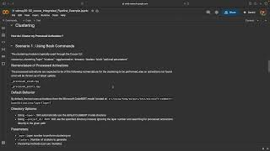
Demo Video

Slide 19
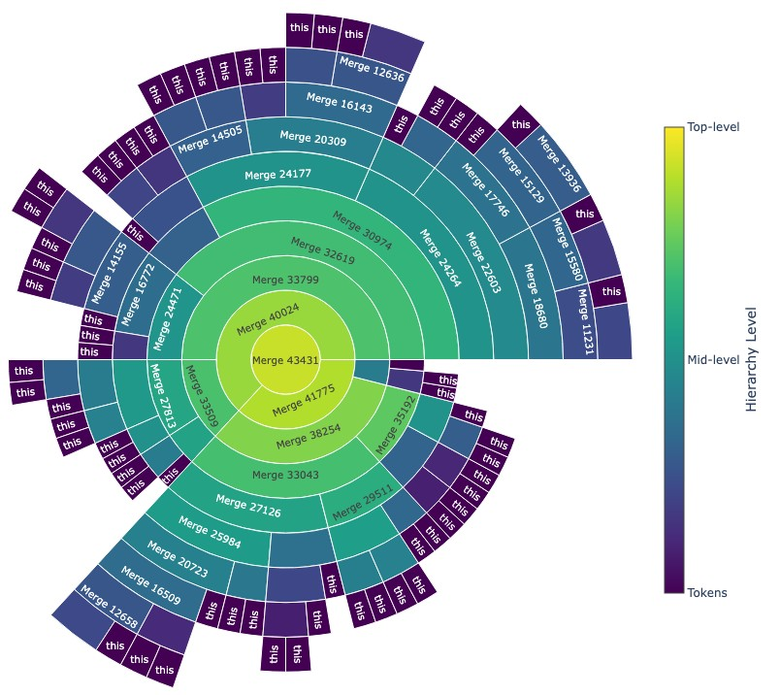
Problems Solved
Enhanced Interpretability
Practical Usability
Intuition

Slide 20
Conclusion

